Slide 1
IoT(Internet of Things).

Slide 2
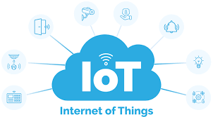
What is IoT?
-A network of interconnected devices that collect and exchange data.
-Its like giving everyday objects an digital brain allowing them to make smart decisions.
Examples:
-Smart Lights -Smart Speakers -Smart watches

Slide 3
How IoT Works?
Devices with Sensors IoT devices are equipped with sensors (e.g., temperature, motion, GPS) to collect data from their environment.
Connectivity These devices connect to the internet using Wi-Fi, Bluetooth, cellular networks, or other communication protocols.
Data Transmission The collected data is sent to a centralized platform (cloud or local server) for processing and analysis.
Control and Feedback Users can monitor and control IoT devices via apps, dashboards, or automated responses. For example, turning on a smart light using your phone.

Slide 4
IoT Applications
Smart Homes: Smart thermostats, lighting, security systems
Smart Cities: Traffic management, waste management, public safety
Wearables: Fitness trackers, smart watches, health monitors
Downsides of IoT
Privacy Concerns
Continuous data collection can compromise user privacy if not properly managed.
High Initial Costs
Setting up IoT systems, including devices, connectivity, and infrastructure, can be expensive.
Complexity
Managing a large number of connected devices can become complicated, especially for non- q technical users.
Dependence on Internet
IoT devices rely on stable internet connectivity. Any disruptions can affect functionality.

Slide 5
end.

